Slide 1
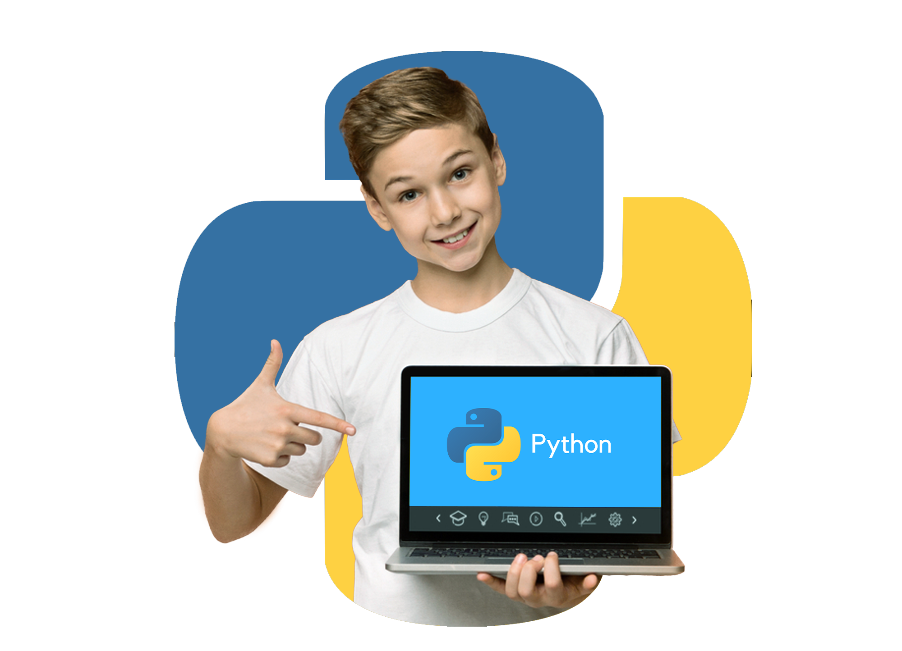
Python Learning Assistant for Children

Slide 2
Team Members
Aya AbdElmoniem Mohamed
Doaa Samir El-Sayed
Ahmed Mostafa AbdEl-Rahman
Mazen Gaber Mahmoud

Slide 3
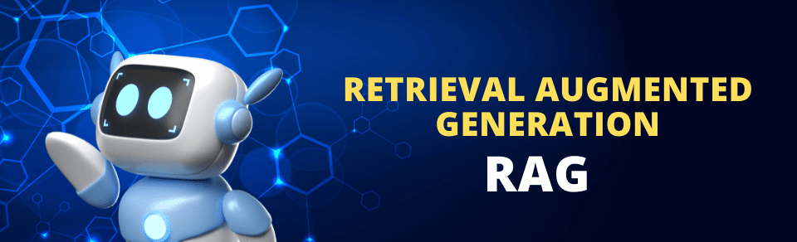
Project Overview
This project develops a child-friendly Python programming assistant that explains coding concepts in simple, accessible ways for young learners aged 8-12.
It uses a Retrieval-Augmented Generation (RAG) system to provide age-appropriate explanations of Python programming concepts.

Slide 4
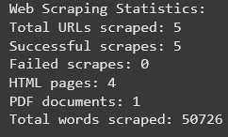
Data Collection
Sources: Programiz.com tutorials + Python documentation
Content: 5 sources, 50,726 words
Types: HTML pages and PDF documents

Slide 5

Text Processing
Cleaning and chunking text
1,064 text chunks created (500 words with 100-word overlap)

Slide 6
Vector Embedding & Database
Used SentenceTransformer (all-MiniLM-L6-v2)
Created ChromaDB vector database
Enabled semantic similarity search

Slide 7
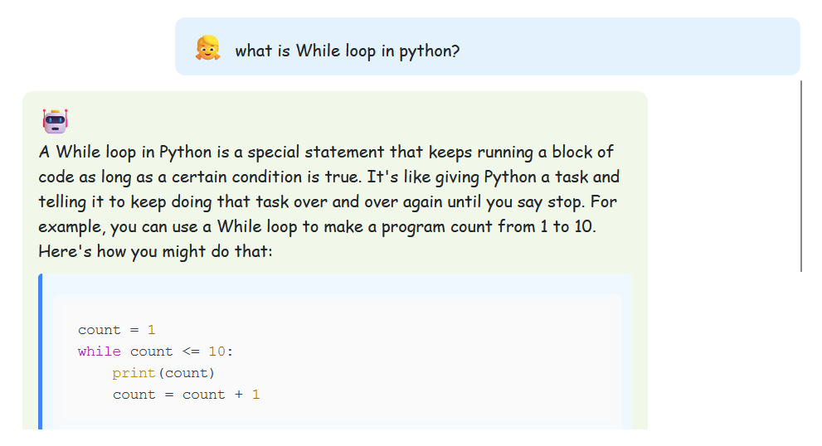
Example 1

Slide 8
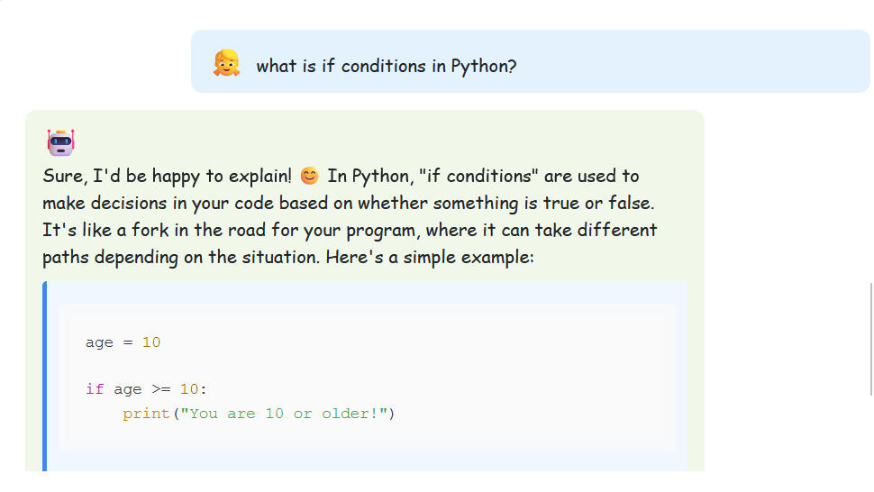
Example 2

Slide 9
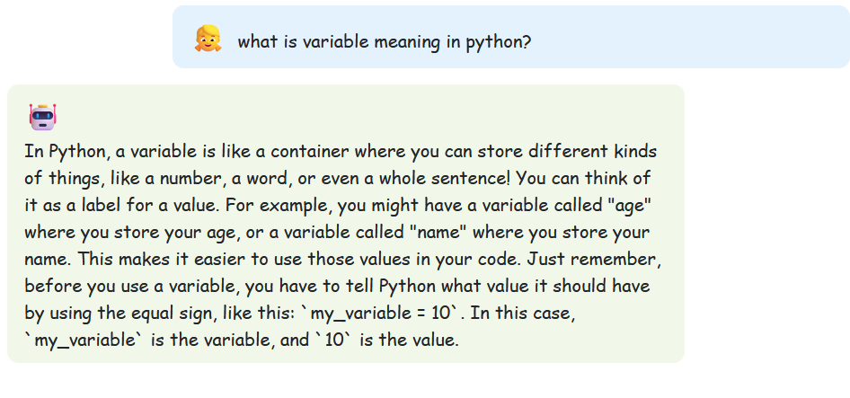
Example 3

Slide 10
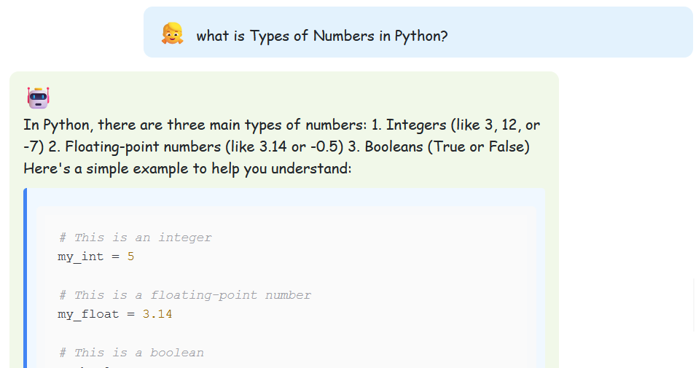
Example 4

Slide 11
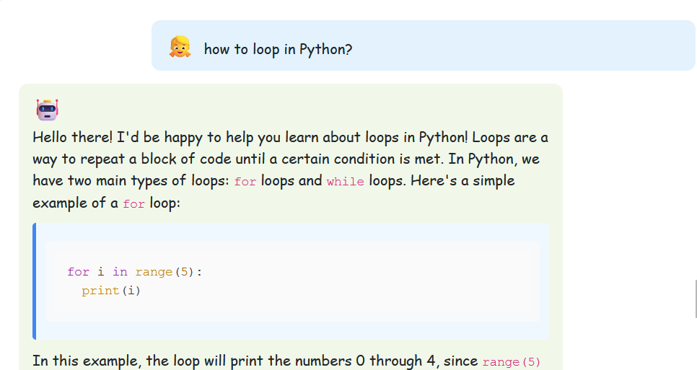
Example 5

